Slide 1

Data Heist

Slide 2





MEET OUR TEAM
Elvis
Fuji
Haolia
Cyntia
Luthfi
Data Heist

Slide 3

Table of Contents
Research Background
Dataset & EDA
Pre-Processing Data
Modeling & Evaluation
Business Insight & Recommendation

Slide 4
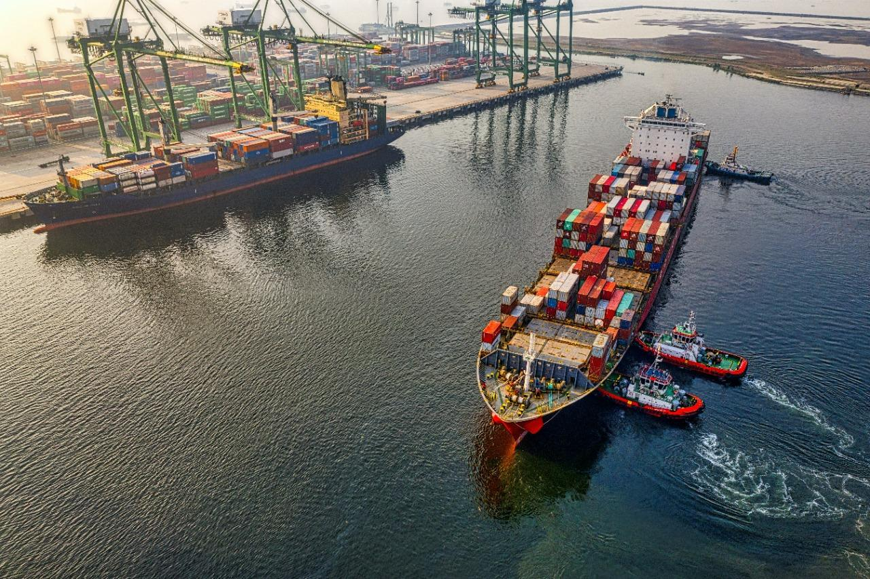
Research Background

Slide 5


WHO ARE WE ?
DATA HEIST
Data Scientist from a consulting company engaged in business consulting
AMAJON
International e-commerce focused on selling electronic products

Slide 6

E-commerce (electronic commerce) is the buying and selling of goods and services, or the transmitting of funds or data, over an electronic network, to reduce service-costs aimed at improving product quality and delivery quality.
Problem Statement
There was a late delivery of 59.7%
Customer Rating 2.99
Solution :
We as consultants can help companies to increase customer retention which at the same time is able to increase the profits of our client companies.

Slide 7

GOAL : Increase the percentage of delivery on time and increase customer rating
OBJECTIVE : Provide insight and build machine learning models to predict Delivery On time
BUSINESS METRIC : Delivery on time, customer rating

Slide 8
DataSet
&
EDA

Slide 9


About this Dataset
ID
Customer_care_calls
Customer_Rating
Cost_of_the_product
Prior_purchases
Discount_offered
Weight_in_gms
Warehouse_block
Mode_of_shipment
Product_importance
Gender
Reach.on.time_Y.N
Duplicate data or missing data
Strange data type
Consist of 10999 rows and 12 column
Column“ID” will be drop

Slide 10
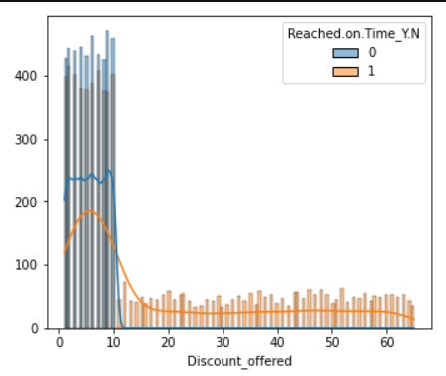
Discount_Offered
When discount < $10, delivery on time is great
When discount > $10, delivery on time is low

Slide 11
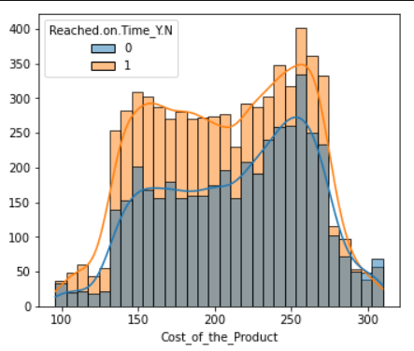
Cost_of_the_Product
Late delivery increased by $130 and decreased by $275

Slide 12
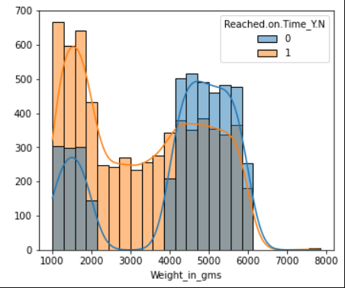
Weight_in_gms
Late delivery is dominant on product weight below 2 kg

Slide 13


Mode_of_shipment
Product_Importance

Slide 14


Customer_Care_Calls
Ratings

Slide 15
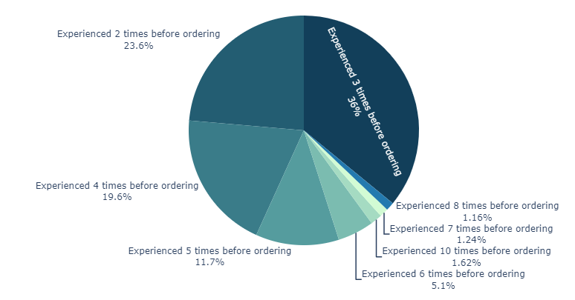
Prior_Purchases

Slide 16
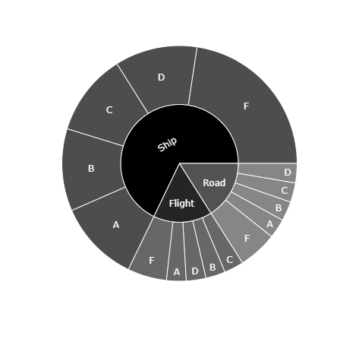
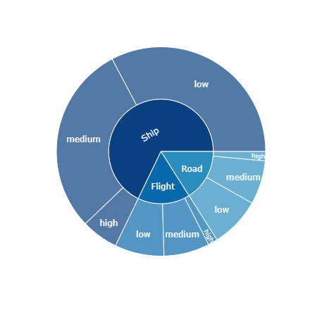
Mode_of_shipment belong to product importance
Mode_of_shipment belong to warehouse

Slide 17
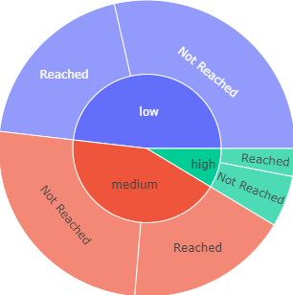
Product_importance_with_reached

Slide 18
Pre-Processing
Data

Slide 19

Split Data 80: 20
Handling Missing Value (No missing value)
Handling Outlier
Outliers in the Prior_purchases column are not removed because their values are still within reasonable limits
Outlier in the Discount_offered column are not removed because the discount given is still within reasonable limits
Boxcox Transformation
Scaling with standar scaler
Feature Encoding Feature selection (ID)
One hot encoding ( Mode of shipment )
Label encoding (Gender, Product importance, Warehouse block)
Class Imbalance
Target feature 60:40 (balance)

Slide 20
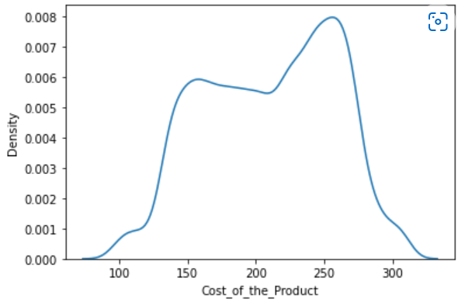
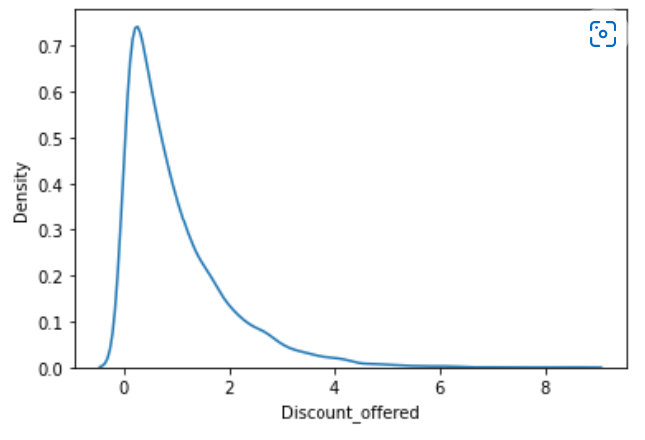
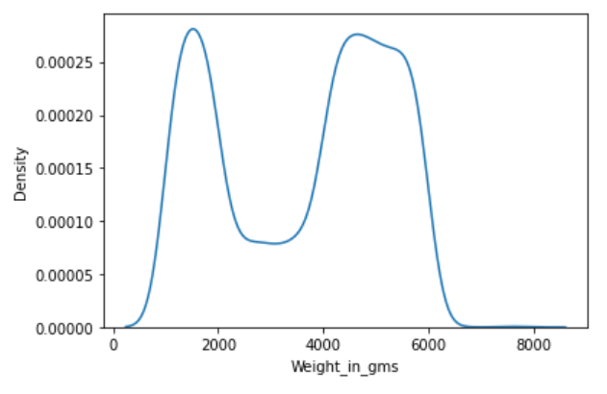
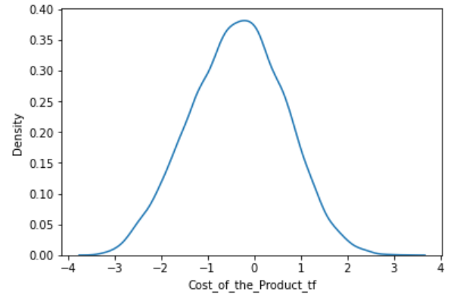
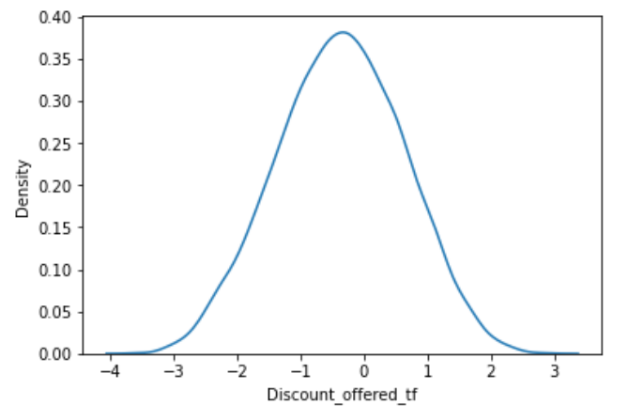
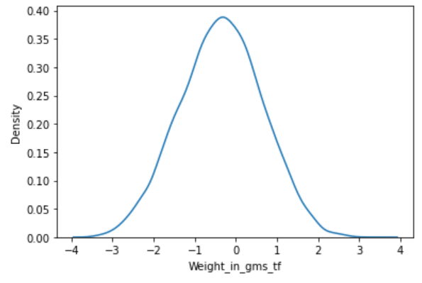
Before Transformation
After Transformation

Slide 21
Model
&
Evaluation

Slide 22
Model Comparison After Hyperparameter Tuning
Model | Train |  |  | Test
 | Accuracy | Recall | Roc_Auc | Accuracy | Recall | Roc_Auc
Logistic Regression | 0.632 | 0.779 | 0.599 | 0.780 | 0.630 | 0.594
Decision Tree | 0.597 | 1.000 | 0.500 | 0.593 | 1.000 | 0.500
KNN | 0.696 | 0.768 | 0.677 | 0.635 | 0.710 | 0.618
SVM | 0.597 | 1.000 | 0.500 | 0.593 | 1.000 | 0.500
Random Forest | 1.000 | 1.000 | 1.000 | 0.661 | 0.668 | 0.659
XGBoost | 0.931 | 1.000 | 0.914 | 0.626 | 0.800 | 0.586
AdaBoost | 0.912 | 0.864 | 0.924 | 0.668 | 0.628 | 0.677
CatBoost | 0.781 | 0.727 | 0.794 | 0.663 | 0.629 | 0.671

Slide 23
Hyperparameter Tuning
Predicted
 | Negative | Positif
Negative | (TN) 471 | (FN) 378
Positif | (FP) 424 | (TP) 927
KNN has the best performance with accuracy 0.635 and ROC-AUC score 0.628
71% Recall of all late deliveries, only 29% were not detected late (False Negative) meaning that the percentage of late deliveries can be predicted better.
Actual
Model | Train |  |  | Test
 | Accuracy | Recall | Roc_Auc | Accuracy | Recall | Roc_Auc
KNN | 0.696 | 0.768 | 0.677 | 0.635 | 0.710 | 0.618

Slide 24
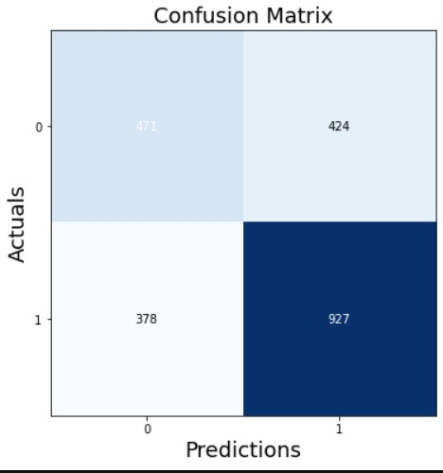
Confusion Matrix
Accuracy = 0.635
Precission = 0.686
Recall = 0.710

Slide 25
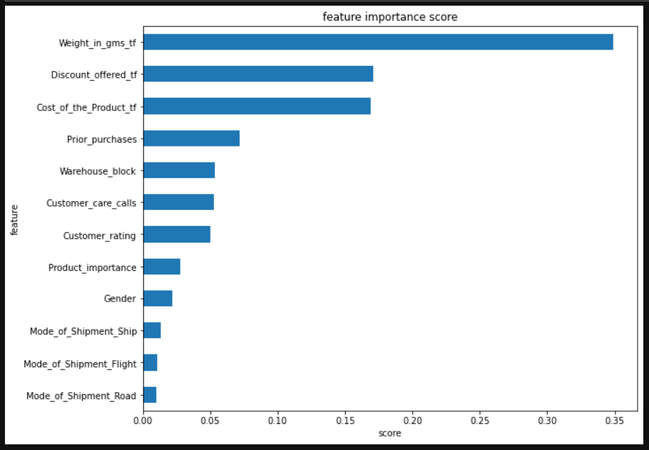
Feature Importance
Weight in Grams
Discount Offered
Cost of the Product
Prior Purchases

Slide 26
Business
Insight
&
Recommendation

Slide 27
On Time Growth Calculation
AFTER MODEL PREDICTION
Feature | var | # | %
Delivery | a | 10.999 | 100%
Late | b | 6.563 | 59.7%
Predicted Late | c | 4.660 | 71%
Predicted on Time | d | 1.903 | 29%
Late after Prediction | e = (b-c) | 1.903 | 17.3%
On Time | f | 4.436 | 40.3%
On Time after Prediction | g = (f+c) | 9.096 | 82.70%
On Time Growth Rate | 4.436 to 9.096 = 105%
EXISTING
Feature | # | %
Delivery | 10.999 | 100%
Late | 6.563 | 59.7%
On Time | 4.436 | 40.3%

Slide 28
Potential Revenue Loss Saved Calculation
 | Delivery a | Total Cost of the Product b | Total Discount c | Total Revenue d = (b-c) | Avg Revenue e = (d/a)
Delivery | 10.999 | $ 2.311.955 | $147.092 | $2.164.863 | $196.8
 | Delivery a | Average Revenue b | Potential Revenue c = (a * b) | % b
Late | 6.563 | $196.8 | $ 1.291.598,4 | 100%
Predicted on Time | 1.903 |  | $ 374.510,4 | 29%
Predicted Late | 4.660 |  | $ 917.088 | 71%

Slide 29
Rating Growth Calculation
 | Delivery a | Total Rating b | Avg Rate c = (b / a)
Delivery | 10.999 | 32.893 | 2.99
Predicted Late Customers potentially increased their rating by 1 (except if the customer already gave rating = 5) | 4.660 - 932(20%) = 3.728 | 32.893 + 3.728 = 36.621 | 3.33
Rating Growth Rate | 2.99 to 3.33 = 11.7%
 | Late | Rate 5
Customers | 6.563 | 1.371 (20%)
20% from all Late customer give 5 rating

Slide 30
Business Insight
Before using the model | After correctly using the KNN model (Recall 0.71)
The number of customers who made transactions was 10999 (4436 received on time) | Orders on time based on predictions: Late order prediction + Order On Time 4660 + 4436 = 9096 (82.70%)
Percentage of orders arriving on time 4463/10999 = 40.33%

Slide 31
Business Recommendation
Create a delivery duration in the form of a range
Increase the estimated duration of package delivery to the customer as a prevention of delays.
Referring to Prior purchases, we create member ranking programs such as golden, silver, and bronze so that discounting will be more effective so that we can retain customers as well.
Added shipping tracking notifications so this can reduce customer care calls

Slide 32
Business Insight
Weight in grams,
we can categorize the priority of an item, so the shipping process can be adjusted to the mode of shipment.
For example, goods with heavy categories can be sent using Ship mode and lighter goods can use other faster modes such as flight.

Slide 33
Business Recommendation
From these results, it can be concluded that giving a discount is quite influential on delivery on time, if the discount given is below 10$, the number of delivery on time will increase.
This is because if there is a big discount, the number of orders will increase and so will delivery late.
If a big discount is offered > more orders > delivery late retention increases
So it is very important for Amajon to think about the discount scheme that will be offered so that the delivery stays according to the estimated time.
Other strategies we can recommend:
Add delivery distance data so that it can provide a clearer picture of the delivery of the goods.
Adding other shipment modes such as two-wheeled land transportation and trains

Slide 34
THANK YOU

Slide 35
Evaluation Metrics
Accuracy : Used because each label has the same importance/ balance
Recall does not allow a large False Negative value so that the True Positive Rate can be identified properly.
Roc AUC ensure that the model can distinguish classes well (not all data is predicted positive/negative) AUC perfect = 1, baseline = 0.5

Slide 36
Hyperparameter Tuning Notes
The hyperparameters used for tuning the best model are:
eta : step size shrinkage to prevent overfitting
gamma : minimum loss reduction needed to create the next partition
max_depth : maximum depth of tree
min_Chid wight : the minimum number of weights on a "child" (partition) where the higher this parameter, the more conservative the model
colsample_bytree : subsample ratio in tree construction
lambda : L2 regularization, where the higher the parameter, the more conservative the model
alpha :L2 regularization, where the higher the parameter, the more conservative the model
tree_method : tree construction algorithm

Slide 37
1- n_neighbors
Since it’s a very fundamental parameter in kNN algorithm, n_neighbors can directly affect the accuracy of the results as well as runtime performance.
2- algorithm
This parameter defines the algorithm that’s used to calculate neighbor distances. It is “auto” by default in Scikit-Learn which works pretty well to identify the ideal algorithm that should be used to calculate distances between sample points.
3- leaf_size
leaf_size offers a great opportunity to fine tune kNN algorithm when performance is a critical criteria.
4- Distance metrics in kNN
metric parameter is used to define the method for distance calculations between sample points in kNN algorithm. By default metric is minkowski with parameter 2 (p=2).

